Slide 1
Face detection in Go and Webassembly
(using the Pigo library)
Endre Simo

Slide 2

What is Pigo?
https://github.com/esimov/pigo

Slide 3
What is Pigo?
- Computer vision library for face detection, pupils/eyes localization and facial landmark points detection
- The only face detection library in the Go ecosystem developed 100% in Go

Slide 4
Why it has been developed?
- All of the existing face detection libraries developed in Go are actually bindings (wrappers) around some C/C++ libraries
- Bindings (using the cgo) most of the times are not cost effective
- Compiling a C library to Go results in slower build times

Slide 5
Why it has been developed?
- The desire of a single binary file is just a desire
- Installing OpenCV sometimes can be daunting
- OpenCV is huge, impossible to deploy it on small platforms where space constraints are important

Slide 6
What are the benefits of using Pigo?
- Very lightweight, no requirements for 3rd party modules and external libraries
- Platform independent, one single executable
- High processing speed
- No need for image preprocessing prior detection
- Simple and elegant API
- CLI application bundled into the library

Slide 7
What are the benefits of using Pigo?
- Fast detection of in-plane rotated faces
- Pupils/eyes localization
- Facial landmark points detection
- WASM (Webassembly) support

Slide 8
Technical overview
- Pigo is constructed around cascade decision trees, but the cascade classifier is in binary format
- The role of a classifier is to tell if a face is present in the current region or not
- The classifier consists of a decision tree, where the results of pixel intensity comparison test are in binary format.

Slide 9
Unpacking the cascade files
- Because the cascades are encoded into a binary tree structure they first need to be unpacked.
- The unpacking method will return in the following struct:
return &Pigo{
treeDepth,
treeNum,
treeCodes,
treePred,
treeThreshold,
}, nil

Slide 10
Regions classification
- We classify the regions based on the parsed binary data
- The classification is based on pixel intensity comparison test encoded in binary format
bintest := func(px1, px2 uint8) int {
if px1 <= px2 {
return 1
}
return 0
}
idx = 2*idx + bintest(pixels[x1], pixels[x2])

Slide 11
Run the cascades
- An image region is considered being face if it passes all the cascade members.
- During the decision tree scanning each detection is flagged with a detection score.
- An image region is considered as face if the detection score is above a certain threshold (~0.995)

Slide 12
Run the cascades
// Detection struct contains the detection results composed of
// the row, column, scale factor and the detection score.
type Detection struct {
Row int
Col int
Scale int
Q float32
}

Slide 13
Cluster detection
- Due to the noisiness of the underlying pixel data, the detector might produce overlaps in detections.

Slide 14

Cluster detection

Slide 15
Cluster detection
- The cascade regions are clustered together by applying an IoU (Intersection over Union) formula over the detection results.

Slide 16

Detection result

Slide 17
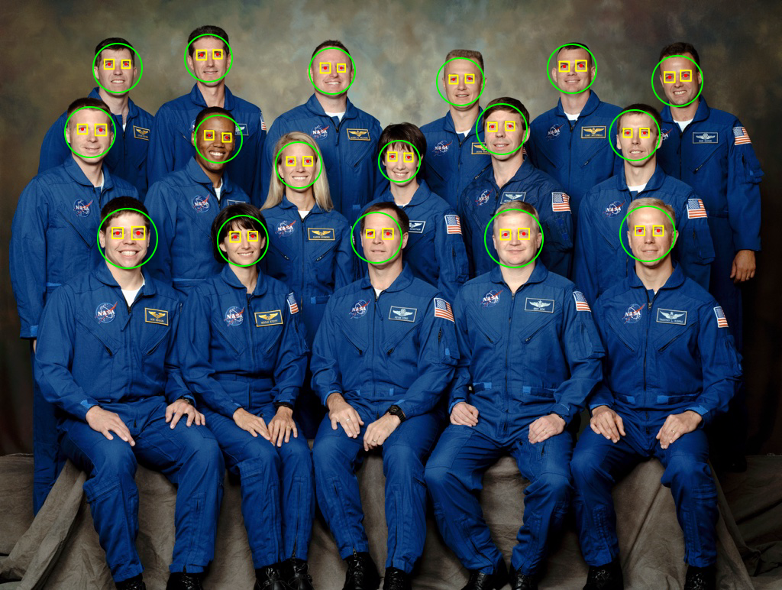
Pupils/eyes localization

Slide 18
Short overview
- The implementation resembles with the face detection method
- The output of the regression trees might be noisy
- Random perturbation factor to outweigh the false positive rates on detection

Slide 19
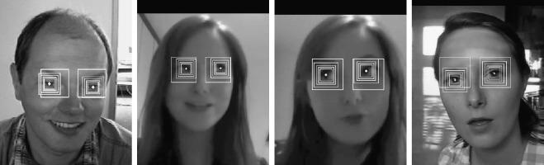
Pupils/eyes localization

Slide 20
Short overview
- The detection function is almost identical for the left and right eye.
// left eye
puploc = &pigo.Puploc{
Row: face.Row - int(0.075*float32(face.Scale)),
Col: face.Col - int(0.175*float32(face.Scale)),
Scale: float32(face.Scale) * 0.25,
Perturbs: perturb,
}
// right eye
puploc = &pigo.Puploc{
Row: face.Row - int(0.075*float32(face.Scale)),
Col: face.Col + int(0.185*float32(face.Scale)),
Scale: float32(face.Scale) * 0.25,
Perturbs: perturb,
}

Slide 21
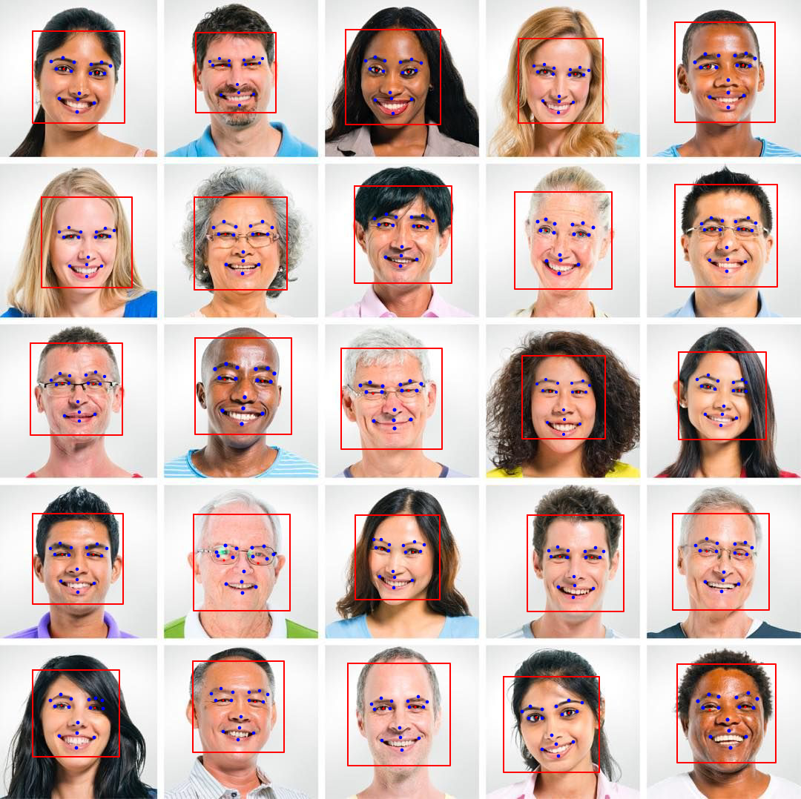
Facial landmark points detection

Slide 22
Landmark points detection
- The landmark points are detected based on the results returned by the pupil localization function

Slide 23
Compute the landmark points
This can be achieved by:
1.) flipping the sign of the column coordinate in tree nodes
2.) flipping the sign in the column coordinate for each binary test

Slide 24
Endre Simo
twitter.com/simo_endre
github.com/esimov
esimov.com

